Slide 1
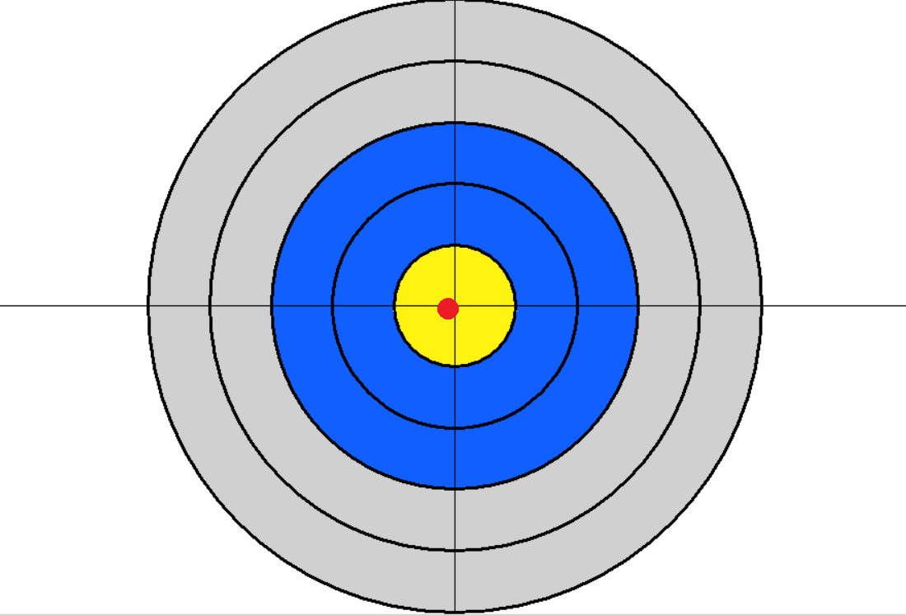
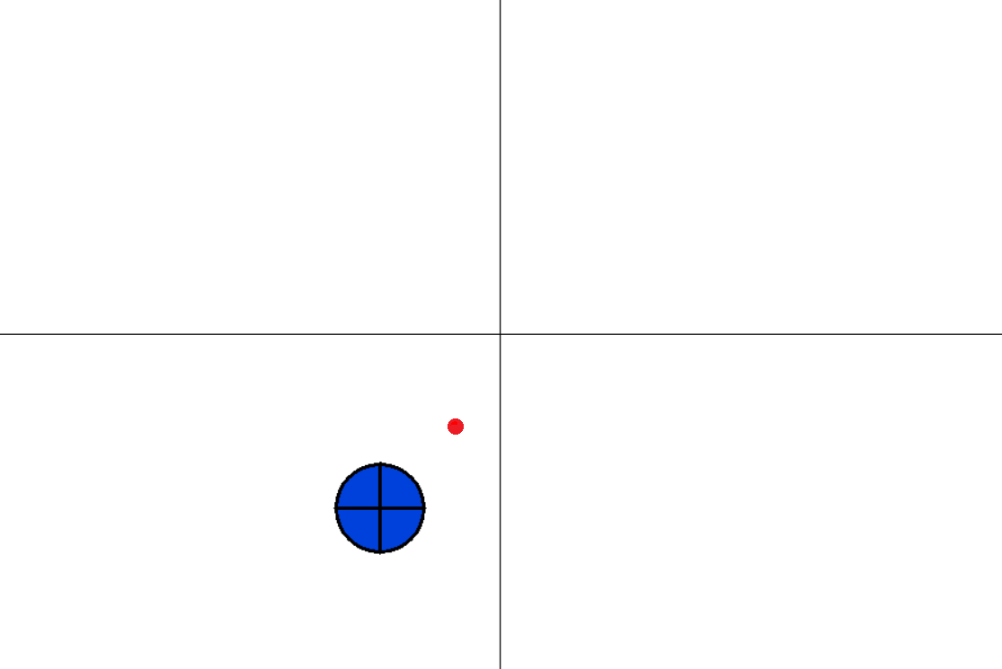
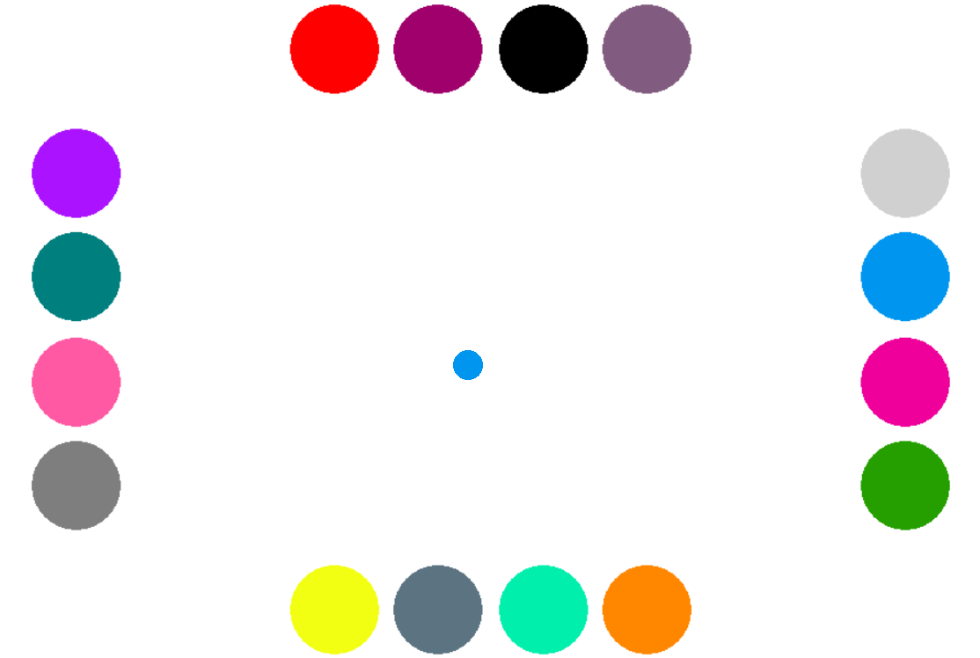
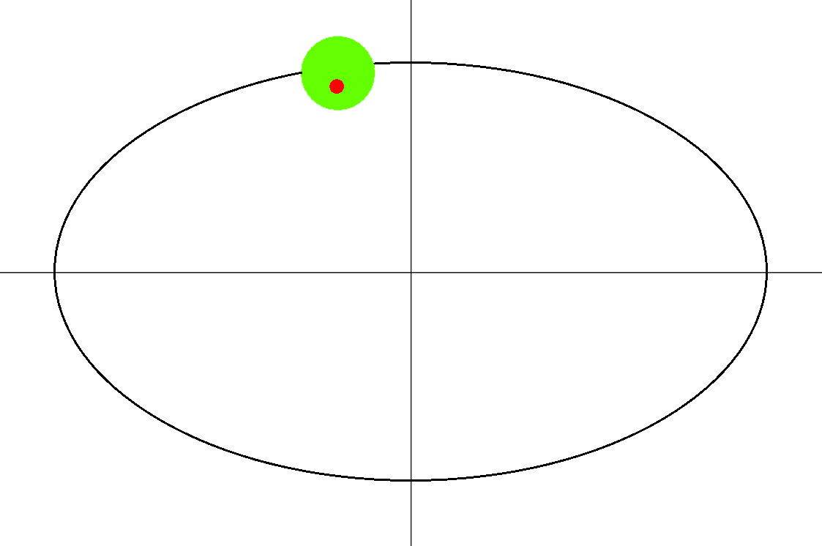
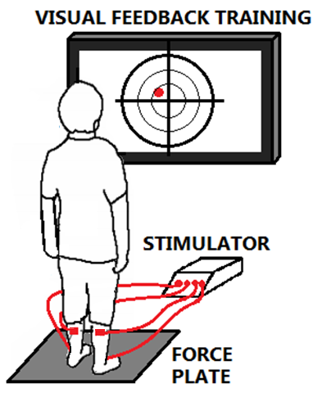
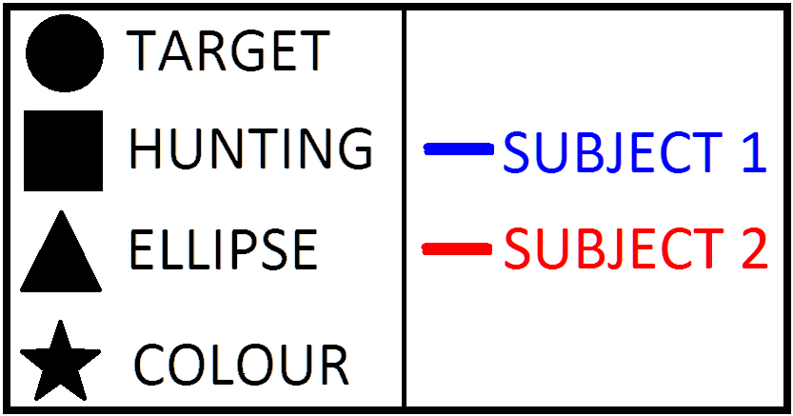
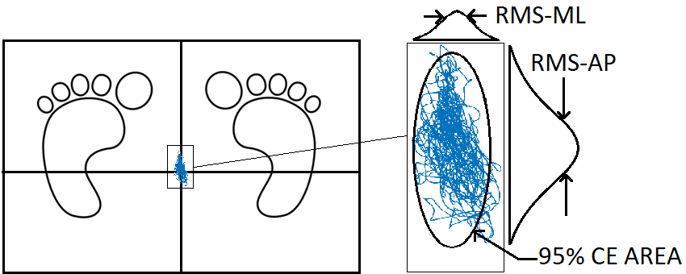
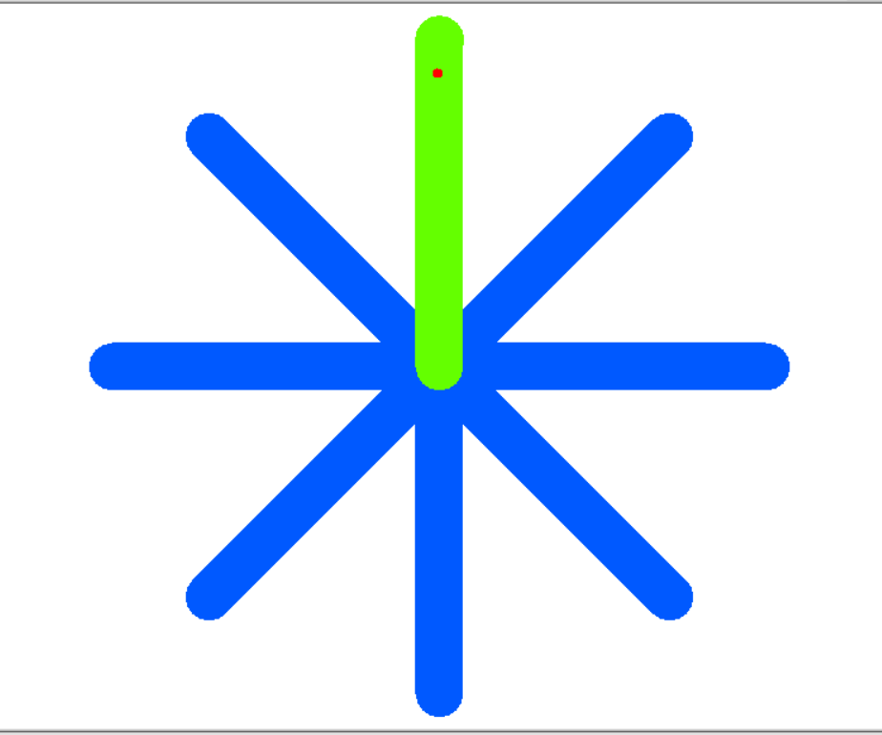
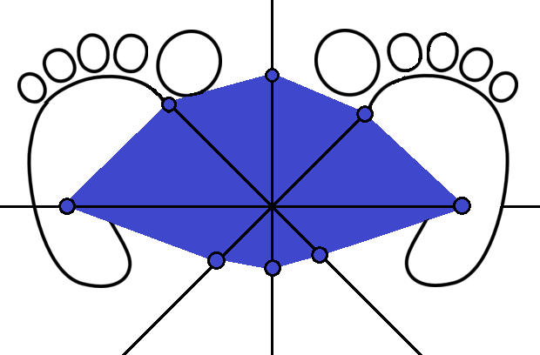
DEVELOPMENT OF VISUAL FEEDBACK TRAINING FOR FUNCTIONAL ELECTRICAL STIMULATION THERAPY FOR BALANCE REHABILITATION
Kelvin Chow¹, Emerson Grabke¹, Jaeeun Yoo¹, Jae Lee¹, Kristin Musselman², Kei Masani^{1,2}
1) Institute of Biomaterials and Biomedical Engineering, University of Toronto
2) Toronto Rehabilitation Institute, University Health Network
Purpose
REHABILITATION GAMES
REST PROTOCOL TO MITIGATE FATIGUE
p=0.27
VOLUNTARY REST
p=0.12
Develop a visual feedback training (VFT) system to integrate with functional electrical stimulation (FES) therapy
p=0.019*
Background
Participants chose whether or not to take breaks in between games
Participants under voluntary rest were affected by fatigue
Individuals with spinal cord injuries often haven balance instability caused by reduced control of lower-limbed muscles
Rehabilitation tools have shown improvements in balance stability
Visual Feedback Training [1]
Functional Electrical Stimulation Therapy [2]
TARGET
HUNTING
MANDATORY REST
p=0.21
p=0.54
p=0.73
Hardware Design
CENTRE OF PRESSURE FEEDBACK
Force plate acquires 16 analog signals passed through NI DAQ; used to calculate centre of pressure (COP)
Visual COP feedback displayed on monitor (LabVIEW)
ELECTRICAL MUSCLE STIMULATOR
4 surface electrodes placed on participant’s shank muscles (tibialis anterior and gastrocnemius)
Electrodes control only anterior-posterior motion
Stimulation current controlled by PD controller using Compex muscle stimulator system
Completed by [3]
Participants forced to take a minimum of 6 breaks during session (>1 min.)
Participants under mandatory rest were not affected by fatigue
Current training system protocol implements mandatory rest periods
COLOUR MATCHING
ELLIPSE
Design Validation
EFFECTIVENESS OF MULTIPLE TRAINING SESSIONS
10 healthy able-bodied participants completed one training session to gather data to validate the training system
2 participants completed 5 sessions each to test effectiveness of VFT over multiple training sessions
GAME PERFORMANCE
STATIC BALANCE
ASSESSMENT
CORRELATION BETWEEN GAME AND ASSESSMENT PERFORMANCE
Training System Design
TARGET
r=-0.87*
r=-0.79*
r=-0.84*
r=-0.01
TRAINING PROTOCOL
Duration: 1 hour (30-40 minutes of standing time)
Static and dynamic balance assessments
Rehabilitation-based training games
r=-0.89*
r=-0.84*
r=-0.92*
r=-0.16
DYNAMIC BALANCE ASSESSMENT
HUNTING
STATIC BALANCE ASSESSMENT
Assessment Performance Indicators
ELLIPSE
r=-0.08
r=0.18
r=-0.07
r=0.20
Root mean square distance – AP (RMS-AP)
Root mean square distance – ML (RMS-ML)
95% Confidence Ellipse Area (95% CE AREA)
Participants show slight improvements over multiple training sessions in game and assessment performance
Conclusion
COLOUR
r=-0.78*
r=-0.58
r=-0.72
r=0.10
A finalized visual feedback training system has been designed and validated, ready for clinical use
This system aims to help individuals with incomplete spinal cord injuries improve their balance ability, thus improving their quality of life
DYNAMIC BALANCE ASSESSMENT
RMS-AP (mm)
RMS-ML (mm)
95% CE AREA (mm²)
DB AREA (mm²)
Next Steps
3 of 4 games show significant correlation to static balance ability, suggesting participants playing these games can improve static balance
Incorporate functional electrical stimulation with training system created by [3]
Test on healthy able-bodied participants to finalize the system
GUI Display
Dynamic Balance Area (DB AREA)
Rehabilitation Engineering Laboratory
Institute of Biomaterials and Biomedical Engineering
University of Toronto
Toronto Rehabilitation Institute | University Health Network
k.masani@utoronto.ca
www.toronto-fes.ca
References
[1] Sayenko et al., Spinal Cord (2010) vol. 48, pp. 886-893
[2] Rouhani et al., Front Neurosci. (2017) 11:347
[3] Grabke et al., UnERD 2017
Notes:
Include hardware design
Swap methods and design

